Slide 1
Hospital Database Management System
- Gaurav Korgaonkar

Slide 2
Problem Statement
Hospitals need a fast and efficient database that maintains data about the Doctors, Staff, Patients, Insurance and Equipment. This database will allow the hospital to keep track of the current patients and store the records related to previous patients in case if it is needed in the future. This will make the process of admission of a patient faster and more importantly easier for the families of the patients. It will also make sure that the hospital never runs out of essential equipment.
Users: 1. Admin 2. Doctor 3. Staff 4. Chemist 5. Receptionist

Slide 3
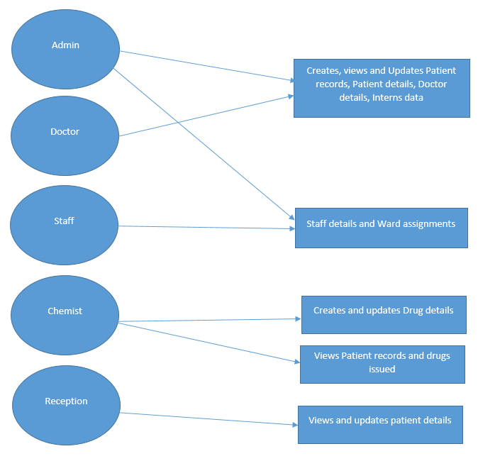
Use case Diagram

Slide 4
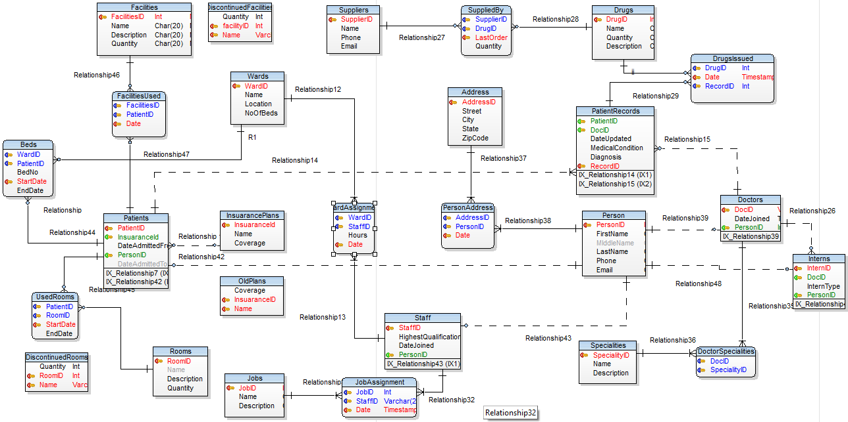
Data Model

Slide 5
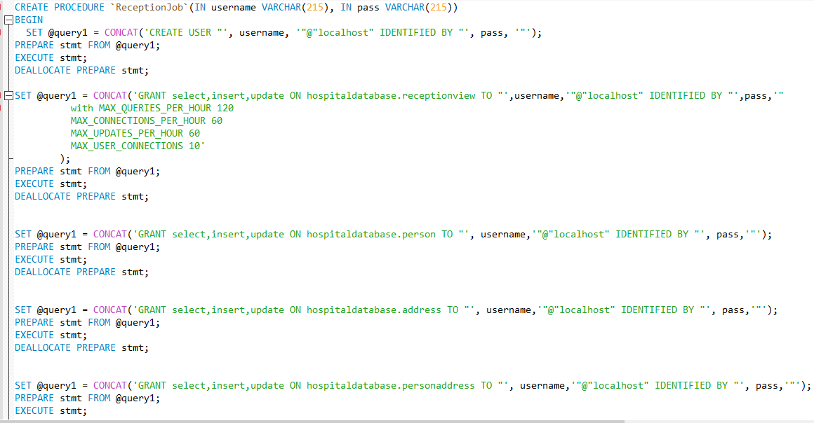
Procedures

Slide 6
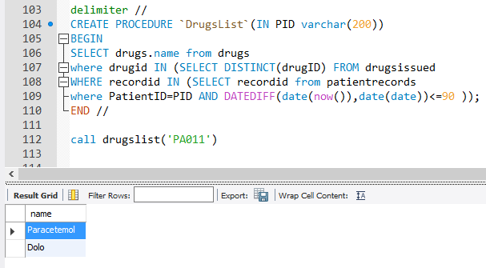

Slide 7
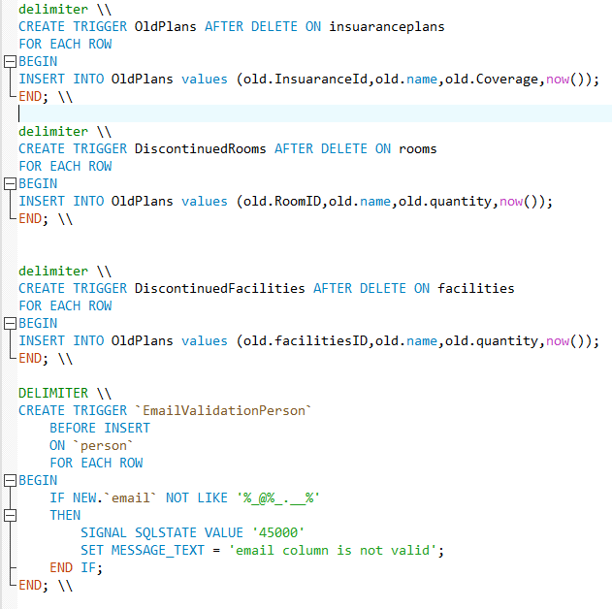
Triggers
To store the details of previous Insuarance Plans and Discontinued Facilities and Rooms
To Validate the Email data in person and supplier tables

Slide 8
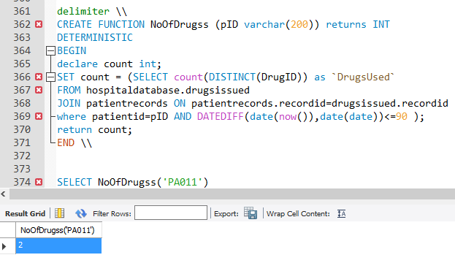
Functions
NoOfDrugs : It displays the number of drugs the patient has taken In the last 90 days.

Slide 9
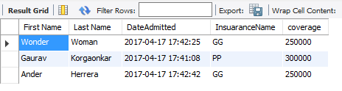
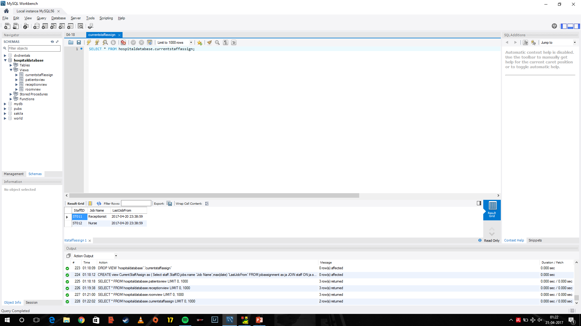
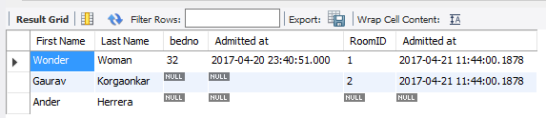
Views
- Patient’s View - Current Staff Jobs
- Reception view

Slide 10
Thank YOU ☺

